Slide 1
Words vs. pseudowords (Broca repeat)

Slide 2
Words vs. pseudowords (Broca repeat)
Does early processing during word
comprehension reflect differences in
lexical status?

Slide 3
Words vs. pseudowords (Broca repeat)
Does early processing during word
comprehension reflect differences in
lexical status?
1. Organization along the temporal lobe

Slide 4
Words vs. pseudowords (Broca repeat)
Does early processing during word
comprehension reflect differences in
lexical status?
1. Organization along the temporal lobe
2. Differences: lexicality or segmental content?

Slide 5
Words vs. pseudowords (Broca repeat)
Does early processing during word
comprehension reflect differences in
lexical status?
1. Organization along the temporal lobe
2. Differences: lexicality or segmental content?
3. Uniqueness points

Slide 6
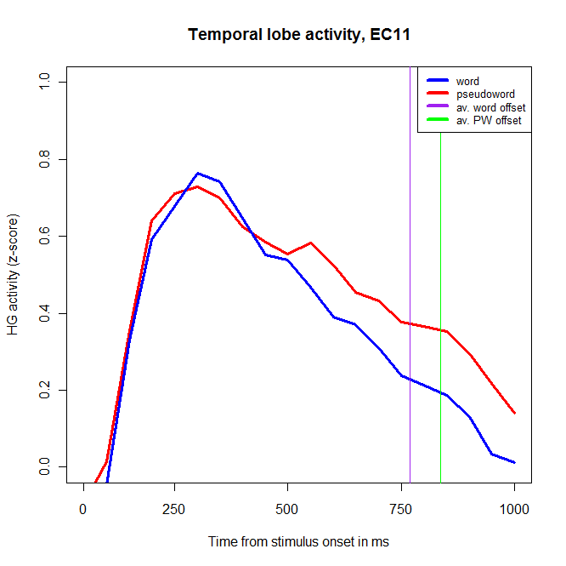
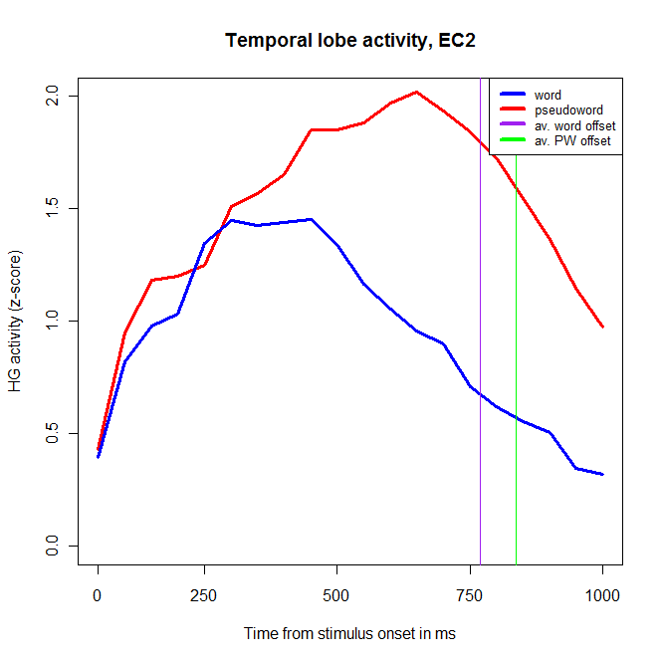
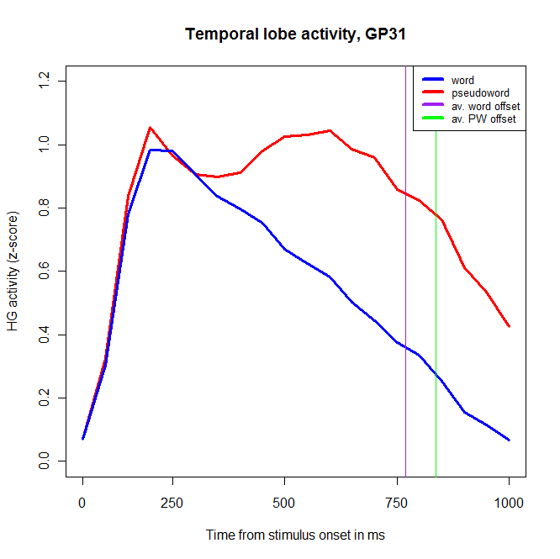
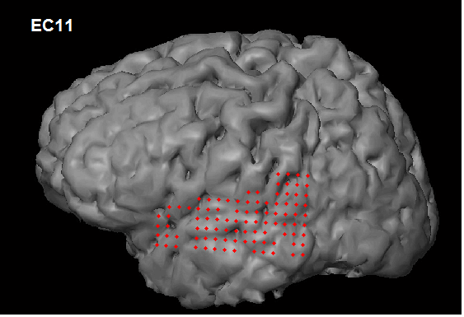
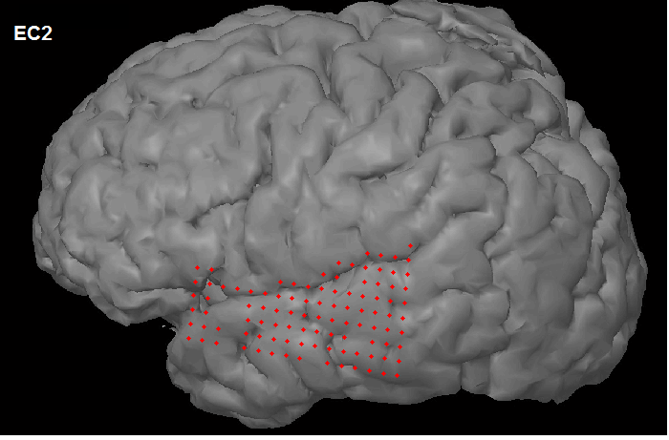
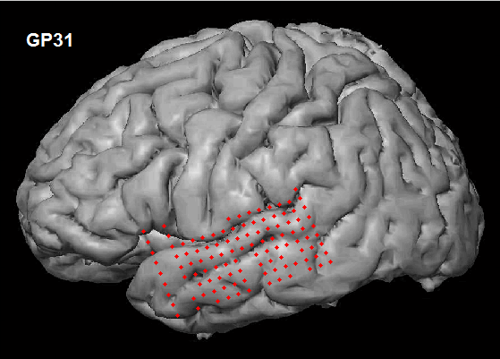
No electrodes show greater activity for words over pseudowords, when averaged over the first second after stimulus onset.

Slide 7
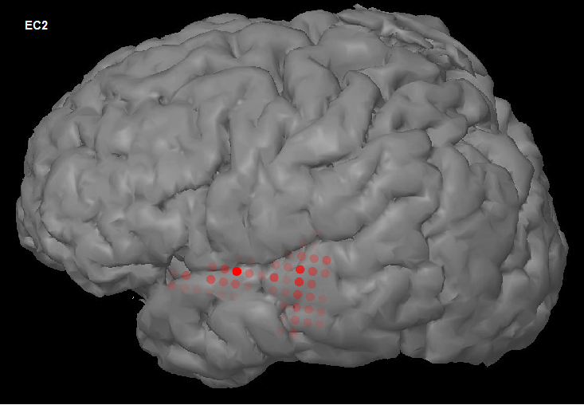
Spatial arrangement of electrodes showing lexicality difference
(pseudowords > words)
min. coeff. of z-score difference, PW-word: 0.43
max. coeff. of z-score difference, PW-word: 4.08
Significant electrodes after Tukey post-hoc
corrections (adjusted p < 0.05).

Slide 8
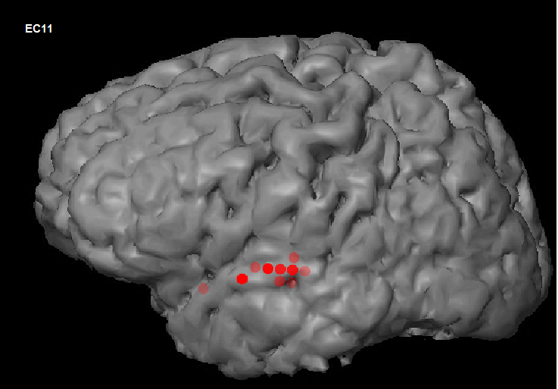
Spatial arrangement of electrodes showing lexicality difference
(pseudowords > words)
min. coeff. of z-score difference, PW-word: 0.33
max. coeff. Of z-score difference, PW-word: 0.82
Significant electrodes after Tukey post-hoc
corrections (adjusted p < 0.05).

Slide 9
Segmental composition of stimuli

Slide 10
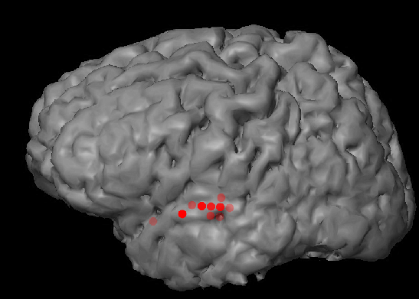
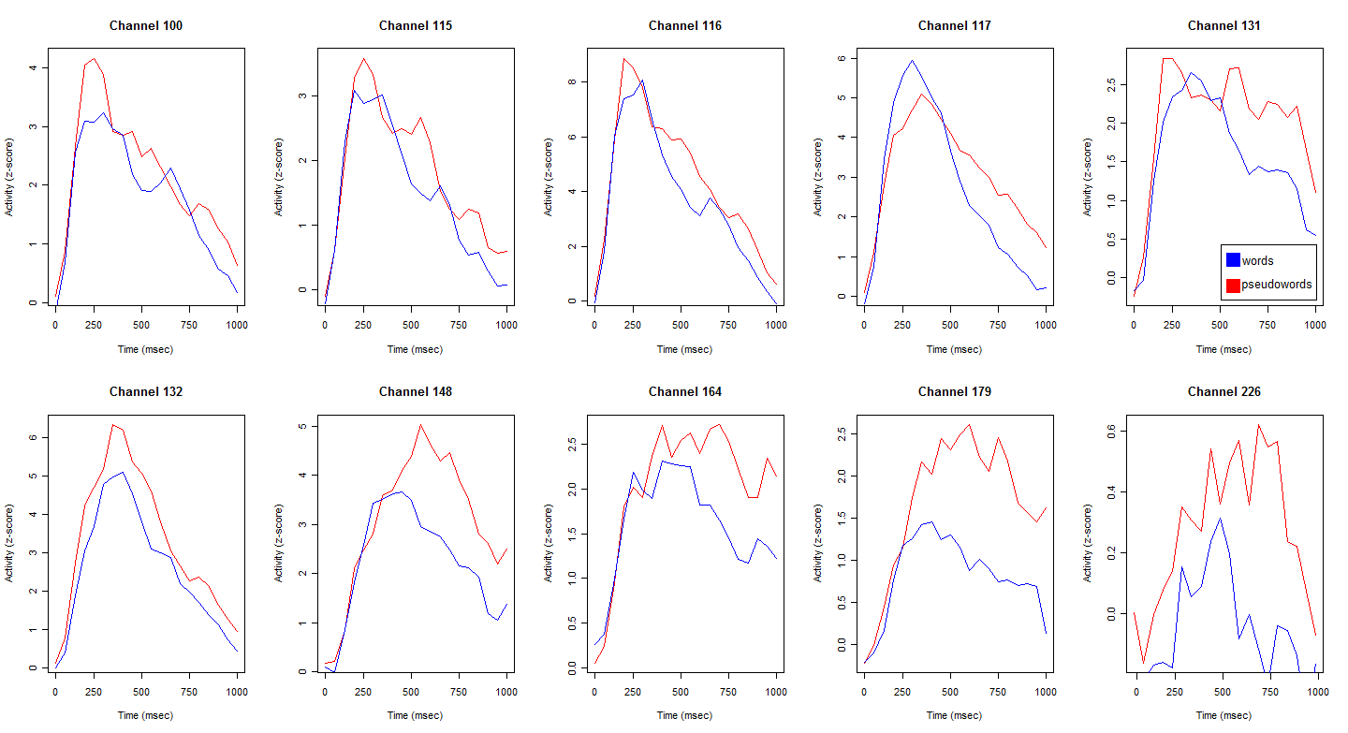
EC11: electrodes that significantly differ on lexicality

Slide 11
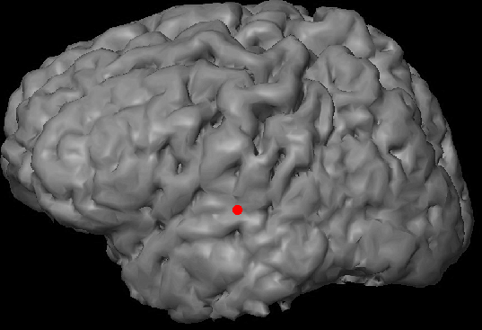
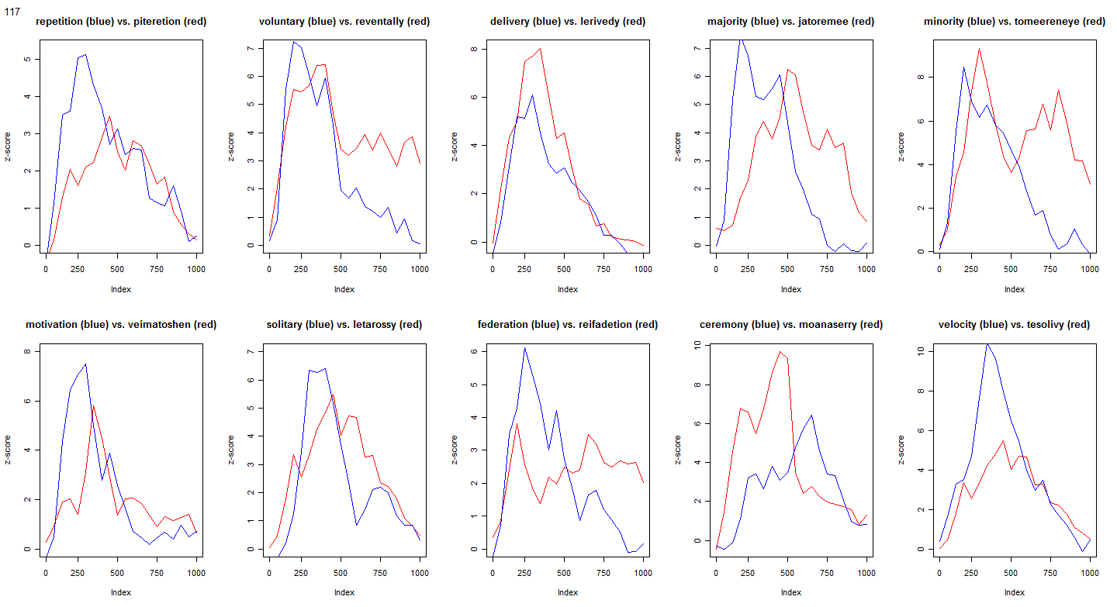
channel 117 greatest word > PW activity

Slide 12
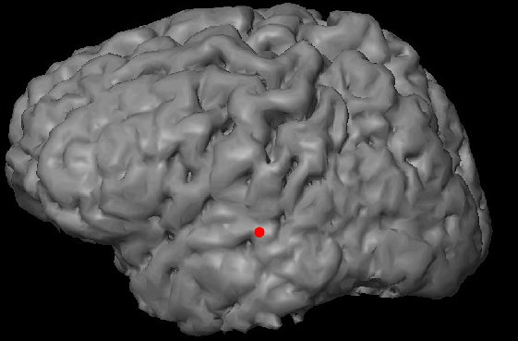
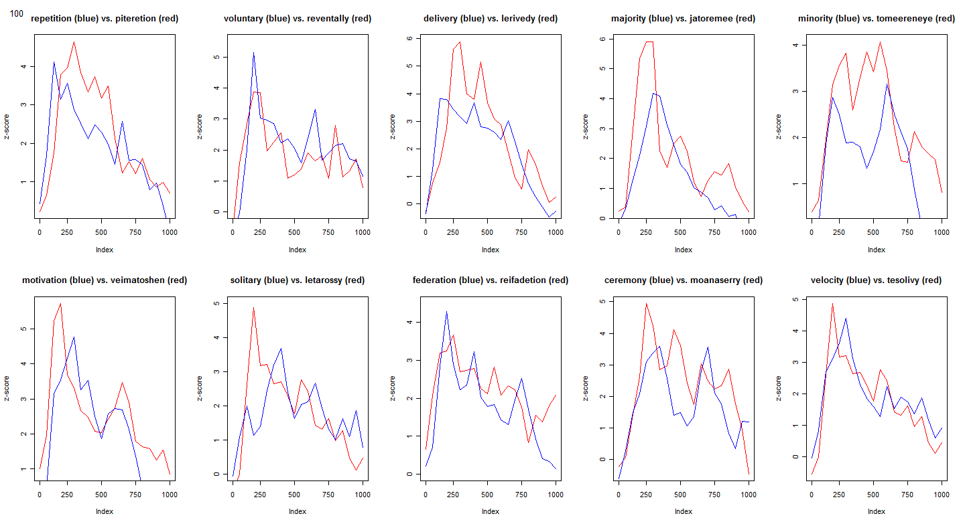
channel 100 least pseudoword > word activity

Slide 13
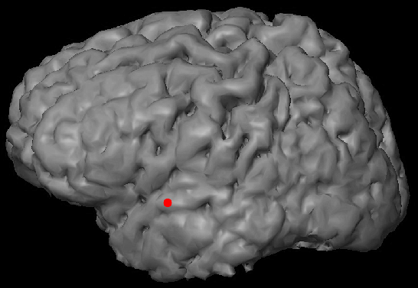
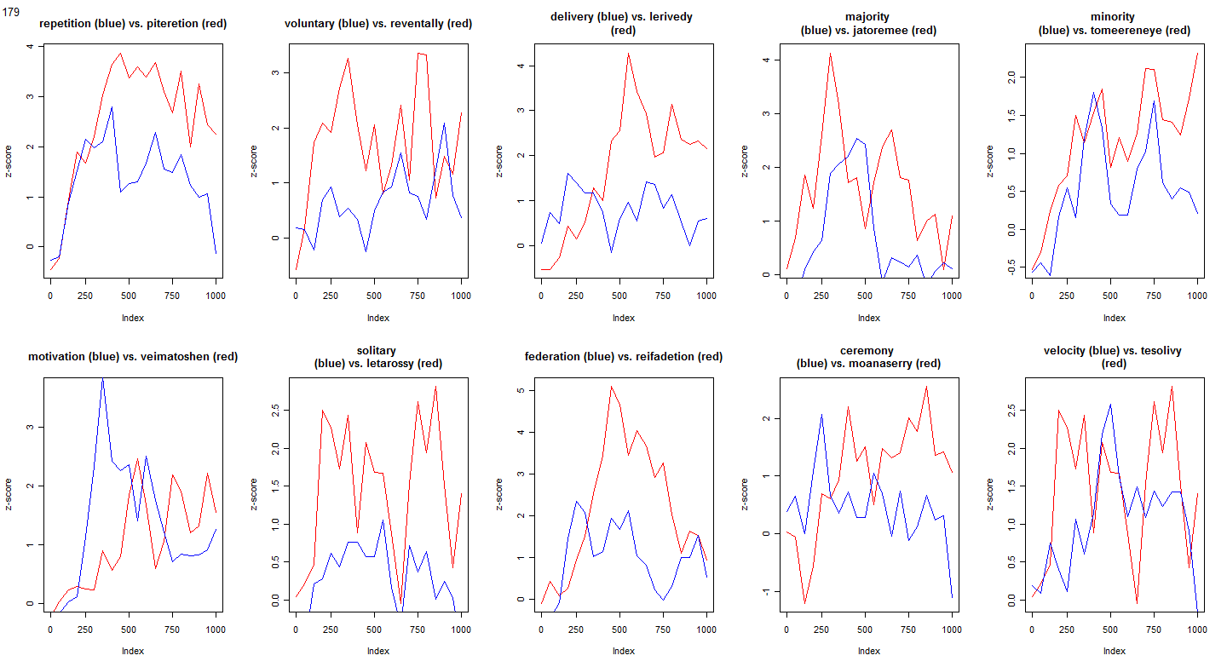
channel 179 greatest PW > word activity

Slide 14
This is pw vs. long easy words across all sig. temp lobe electrodes

Slide 15
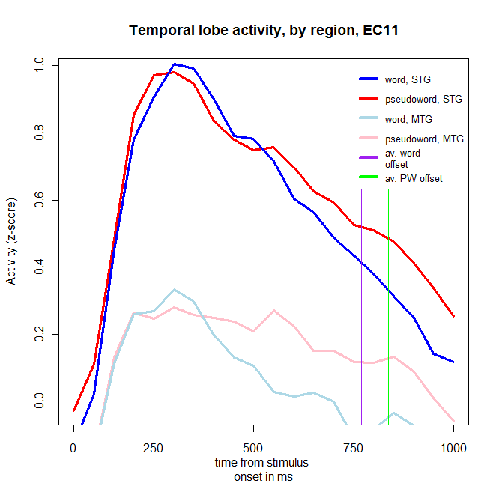
this is split into stg and mtg

Slide 16
This is pw vs. long easy words across all sig. temp lobe electrodes

Slide 17
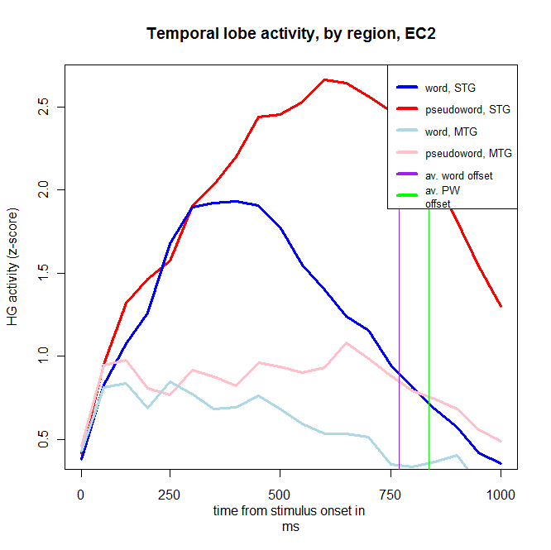
this is split into stg and mtg

Slide 19
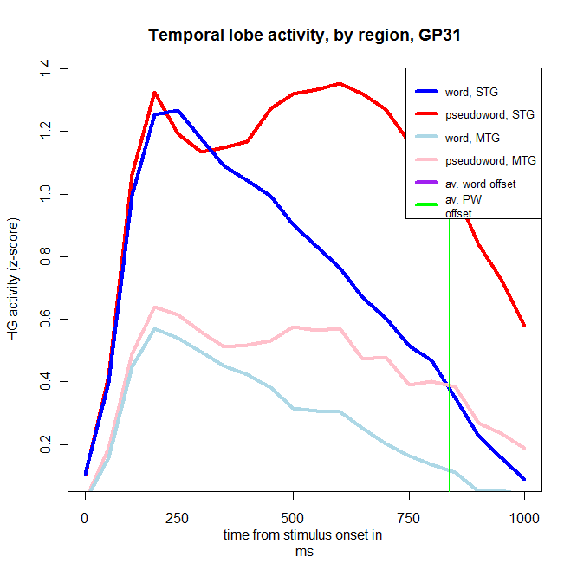

Slide 20
Correlation between phonological uniqueness point and peak temporal lobe activity?

Slide 21
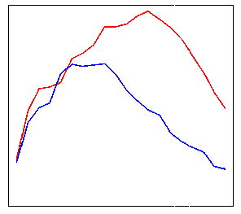
Correlation between phonological uniqueness point and peak temporal lobe activity?

Slide 22
Uniqueness points:
Real words
* plurals?
** familiar competitors?
*** stress? (e.g. Soto-Faraco et al. 2001, JML, Cooper et al. 2002, Lang. & Speech)
Word | Uniqueness point | Word | Uniqueness point
velocity*,** | velo- | delivery | delivery
majority*,** | majo- | motivation | motivation
minority* | minorit- | solitary | solita-
repetition | repetition | federation*, *** | fe-
voluntary** | volun- | ceremony* | ceremo-

Slide 23
Uniqueness points:
Pseudowords
Pseudoword | Uniqueness point | Pseudoword | Uniqueness point
tesolivy | teso- | lerivedy | ler-
jatoremee | jat- | veimatoshen | veim-
tomeereneye | tomee- | reifadetion | reif-
piteretion | pit- | moanaserry | moanase-
reventally | reven- | letarossy | let-
Average uniqueness point (after stimulus onset):
- Words: 545 ms
- Pseudowords: 336 ms

Slide 24
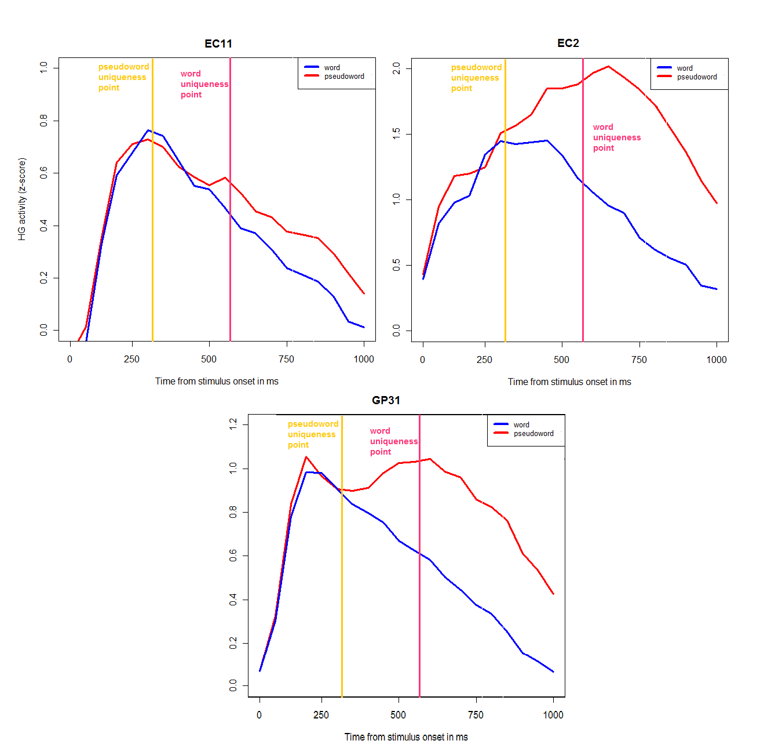

Slide 25
Summary
Possible increase in sensitivity to lexical status in more anterior temporal lobe
  Reflected in time course of activity?
Possibly not attributable to phonological (segment) content
Uniqueness point of stimuli: not very telling (at the averaged level, at least)

